Slide 1
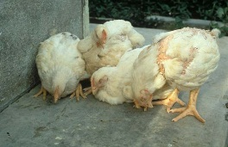
poultry diseases 1 (xpkkoju)
fourth stage
شعار الكلية
يمكن اضافة صورة تتلائم مع اسم المادة
chapter one – Nutritional Deficiency Diseases- lecture 1
Dr.Harith Abdulla
Department of Pathology and Poultry Disease
College of veterinary medicine university of basrah
University of Basrah- College of veterinary medicine- Department of Pathology and Poultry Disease

Slide 2
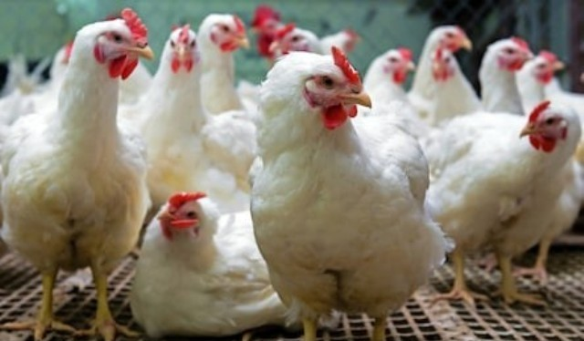
Poultry diseases
Poultry are kept all over the world for various reasons. They are one of the cheapest sources of meat and can be kept by anyone. Poultry are kept by large commercial farmers for meat or egg production, by smaller farmers and by house holds in backyards.
When chickens are healthy they eat less food and produce more meat and eggs. They are less trouble to look after and less money is spent
on medical costs.

Slide 3
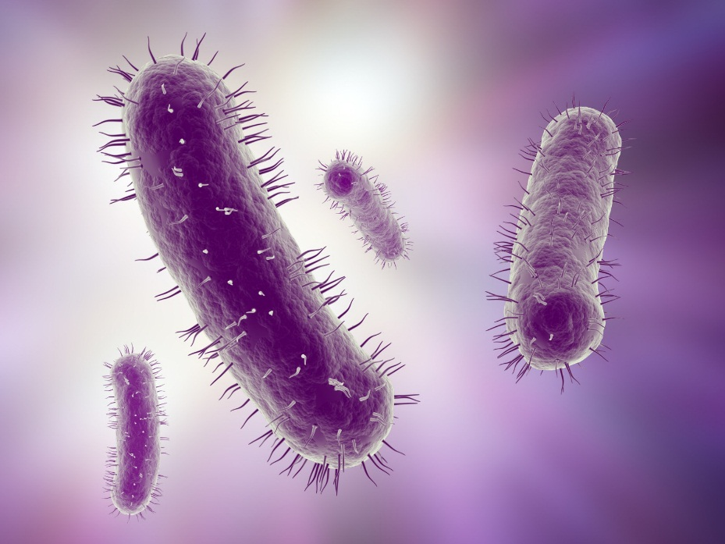
disease???
A pathological condition of a body part, an organ, or a system resulting from various causes, such as infection, genetic defect, or environmental stress, and characterized by an identifiable group of signs or symptoms.
Causes of disease
Nutrient Deficiencies
Infectious agents
Environmental conditions

Slide 4
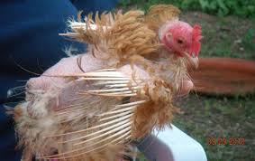
Common signs of disease in poultry
feather loss (unless birds are going
through a natural moult)
general inactivity
discharges
abnormal droppings
dull and/or closed eyes
ruffled feathers
drooped wings
sitting on haunches or lying down.

Slide 5
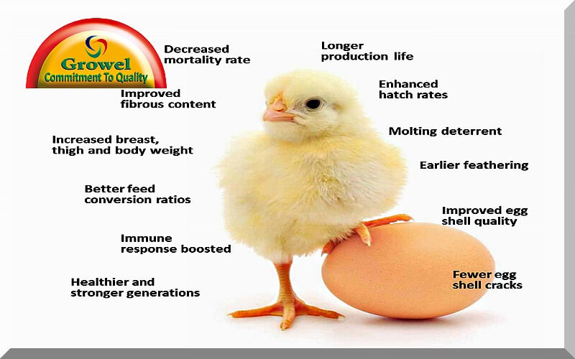
Nutritional Deficiency Diseases
Vitamins ?
The amounts of
various vitamins needed
in poultry diets are very low. The vitamins function as cofactors for enzymes, hormones (e.g., vitamins A, D), or antioxidants (vitamin E).

Slide 6
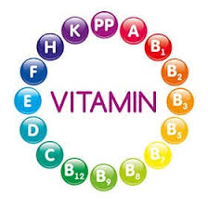
Types of Vitamins
The fat-soluble vitamins
A, D, ,k and E are stored
relatively well and birds
can with stand long periods
of depletion before deficiency symptoms manifest.
Water-soluble vitamins are not stored to a large extent, excesses are excreted mostly in urine, and they are relatively nontoxic.

Slide 7
Vitamin A
is required for the health of the membranes of the digestive, urinary, reproductive and respiratory systems. A vitamin A deficiency can result when the level in the diet is inadequate or the vitamin added to the diet is oxidized by rancid fat in the diet. Additionally, neomycin, a common antibiotic, decreases the absorption of vitamin A. Vitamin A is a fat-soluble vitamin and an inadequate level of fat in the diet could also limit its absorption, even if in the diet at adequate levels.

Slide 8
Vitamin A Deficiency
Vitamin A deficiency in the embryo results in a grossly abnormal cardiovascular system, characterized by an absence of vascular networks.
In chickens and turkeys (insufficient vitamin A during 1-7 weeks of age). As in the case of other nutritional deficiencies, classic signs of deficiency are very rare in commercial poultry fed complete diets.

Slide 9
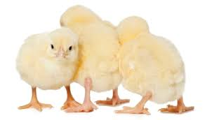
Functions of vitamin A :
Vitamin A is essential
in poultry rations for:
a- Growth.
b-Optimum vision.
c-Maintaining the integrity
of the mucous
membrane.
General Signs
1-Poor growth. 2-Poor feathering.
3-Drowsiness. 4.Off food. 5-Pale comb and wattles.6-Rough feathers.

Slide 10
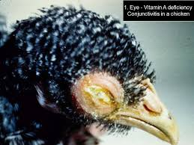
Special Signs of Vitamin A Deficiency:
1-Watery nasal and ocular discharge.
2-Eyelids stuck together with thick milky exudates.
3-Decrease egg production.
4-Increase embryonic mortality.
5-Ataxia.
6-Xerophthalmia.
7-Caseous material
under the eyelids.

Slide 11
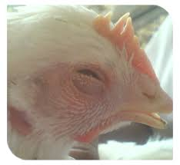
Post_mortem lesions:
Because epithelial linings of alimentary, urinary, genital, and respiratory systems are composed of mucous membranes, these are the tissues in which lesions of vitamin A deficiency are most readily observed as:
1-Eyelids inflamed and adhered.
2-Excessive urates in kidneys and ureters.
3-Pustules in mouth and pharynx.
4-Enlarged gall bladder.
5-Small ulcers at the site
of the lesions.

Slide 12
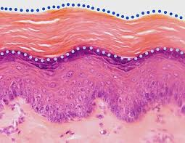
Histopathology :
1-Atrophy of cytoplasm and loss of cilia in the
columnar ciliated epithelium of the respiratory tract .
2-Respiratory epithelium transformed into
stratified squamous keratinized epithelium.
Diagnosis:
1- Feed formulation.
2-Signs.
3-Lesions.
4-Histopathology.

Slide 13
Differential diagnosis:
1-Infectious coryza.
2-Chronic fowl cholera.
3-Infectious sinusitis.
4-Avian pox.
5-Trichomoniasis.
6-Thrush.
Prevention: Supplementation of diet with vitamin A.
Treatment:
vitamin A in drinking water

